Slide 1
Inference in First-Order Logic
Proofs
Unification
Generalized modus ponens
Forward and backward chaining
Completeness
Resolution
Logic programming

Slide 2
Inference in First-Order Logic
Proofs – extend propositional logic inference to deal with quantifiers
Unification
Generalized modus ponens
Forward and backward chaining – inference rules and reasoning
program
Completeness – Gödel’s theorem: for FOL, any sentence entailed by
another set of sentences can be proved from that set
Resolution – inference procedure that is complete for any set of
sentences
Logic programming

Slide 3
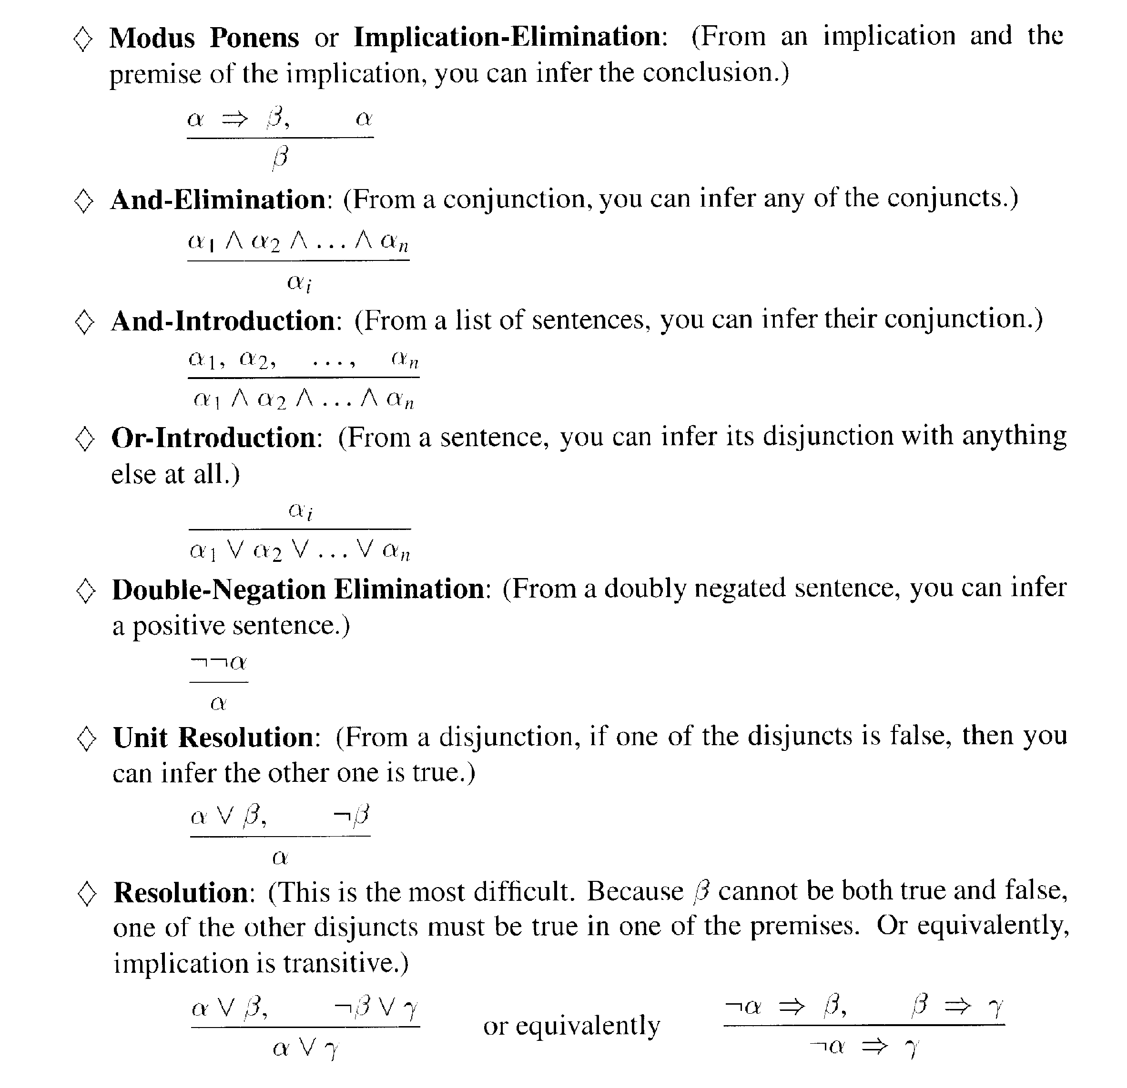
Remember: propositional logic

Slide 4
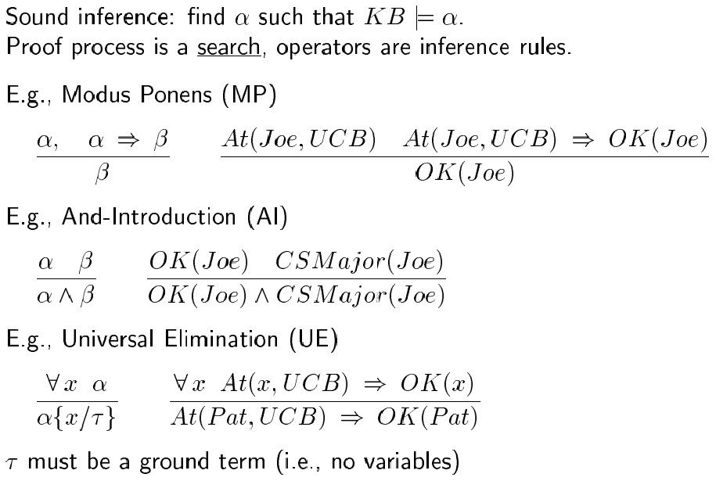
Proofs

Slide 5
Proofs
The three new inference rules for FOL (compared to propositional logic) are:
Universal Elimination (UE):
for any sentence α, variable x and ground term τ,
∀x α
α{x/τ}
Existential Elimination (EE):
for any sentence α, variable x and constant symbol k not in KB,
∃x α
α{x/k}
Existential Introduction (EI):
for any sentence α, variable x not in α and ground term g in α,
α
∃x α{g/x}

Slide 6
Proofs
The three new inference rules for FOL (compared to propositional logic) are:
Universal Elimination (UE):
for any sentence α, variable x and ground term τ,
∀x α e.g., from ∀x Likes(x, Candy) and {x/Joe}
α{x/τ} we can infer Likes(Joe, Candy)
Existential Elimination (EE):
for any sentence α, variable x and constant symbol k not in KB,
∃x α e.g., from ∃x Kill(x, Victim) we can infer
α{x/k} Kill(Murderer, Victim), if Murderer new symbol
Existential Introduction (EI):
for any sentence α, variable x not in α and ground term g in α,
α e.g., from Likes(Joe, Candy) we can infer
∃x α{g/x} ∃x Likes(x, Candy)

Slide 7
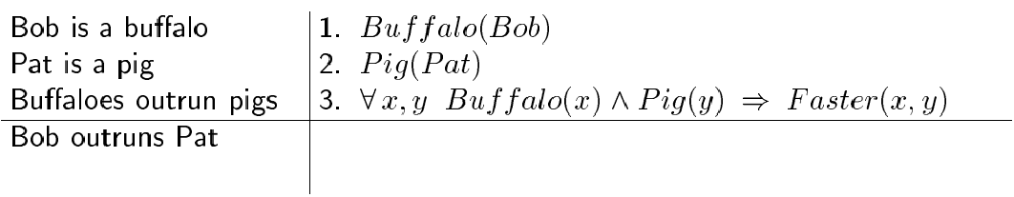
Example Proof

Slide 8

Example Proof

Slide 9
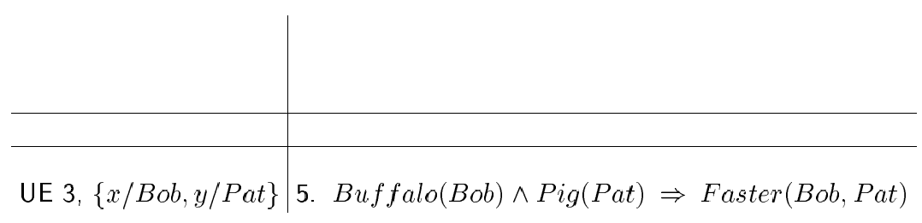
Example Proof

Slide 10

Example Proof

Slide 11
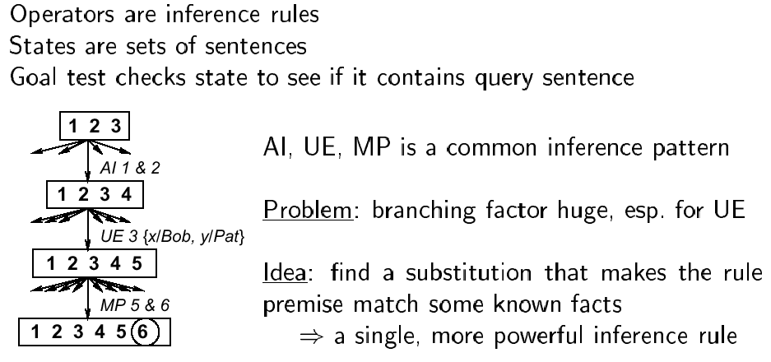
Search with primitive example rules

Slide 12
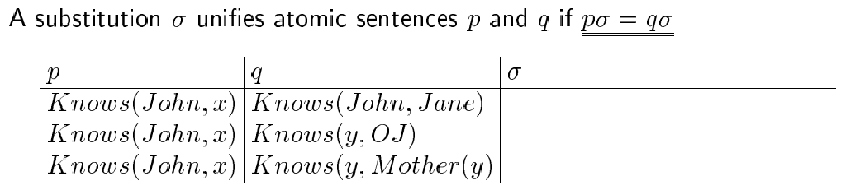
Unification

Slide 13
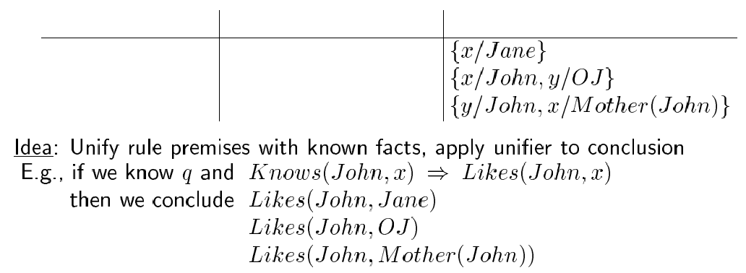
Unification

Slide 14
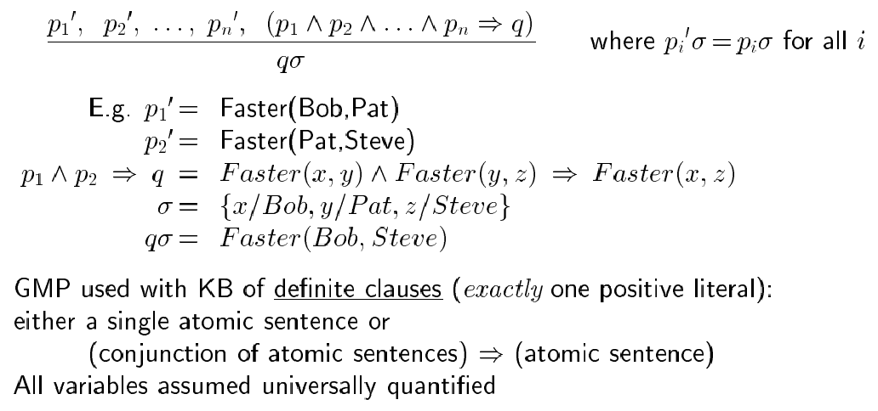
Generalized Modus Ponens (GMP)

Slide 15
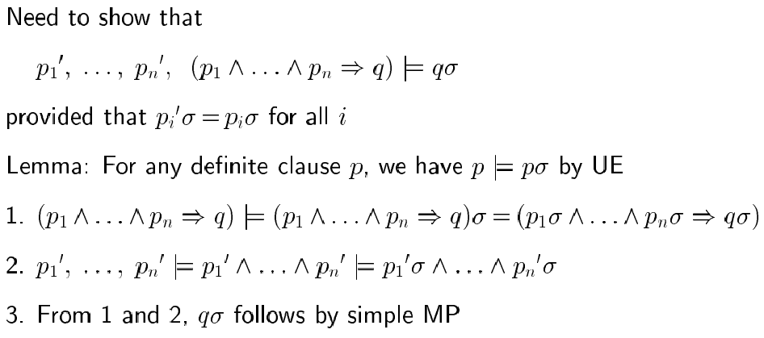
Soundness of GMP

Slide 16
Properties of GMP
Why is GMP and efficient inference rule?
- It takes bigger steps, combining several small inferences into one
- It takes sensible steps: uses eliminations that are guaranteed
to help (rather than random UEs)
- It uses a precompilation step which converts the KB to canonical
form (Horn sentences)
Remember: sentence in Horn from is a conjunction of Horn clauses
(clauses with at most one positive literal), e.g.,
(A ∨ ¬B) ∧ (B ∨ ¬C ∨ ¬D), that is (B ⇒ A) ∧ ((C ∧ D) ⇒ B)

Slide 17
Horn form
We convert sentences to Horn form as they are entered into the KB
Using Existential Elimination and And Elimination
e.g., ∃x Owns(Nono, x) ∧ Missile(x) becomes
Owns(Nono, M)
Missile(M)
(with M a new symbol that was not already in the KB)

Slide 18
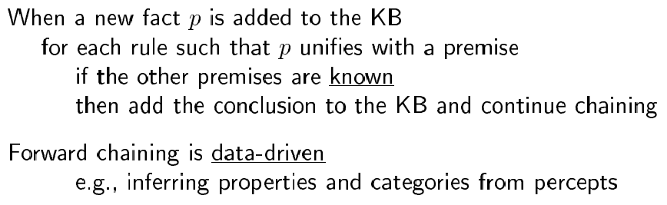
Forward chaining

Slide 19
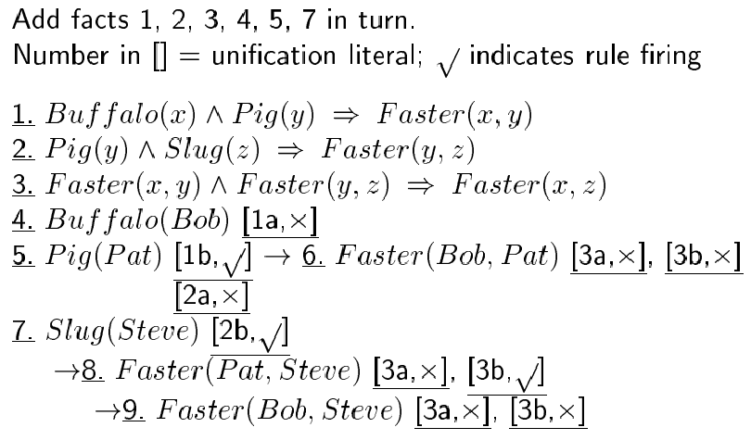
Forward chaining example

Slide 20
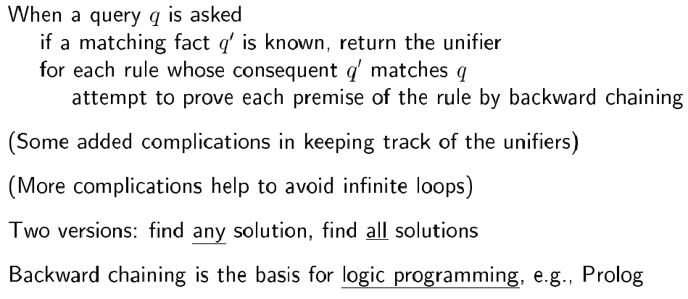
Backward chaining

Slide 21
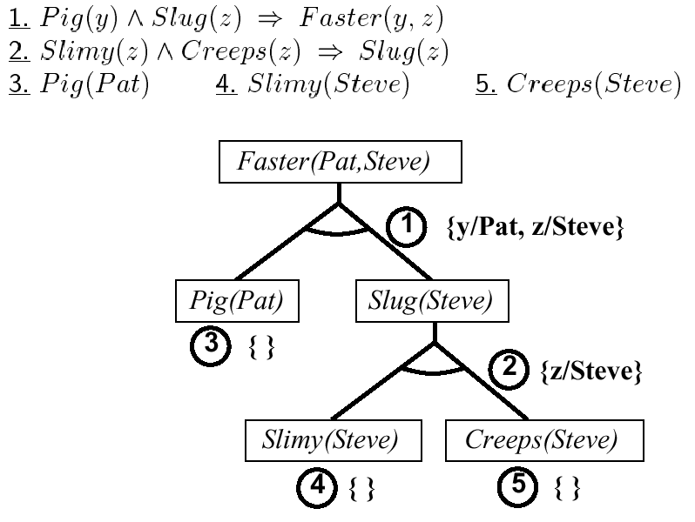
Backward chaining example

Slide 22
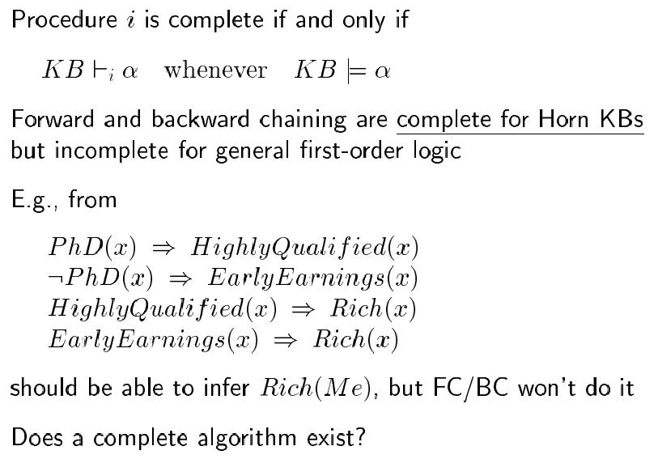
Completeness in FOL

Slide 23
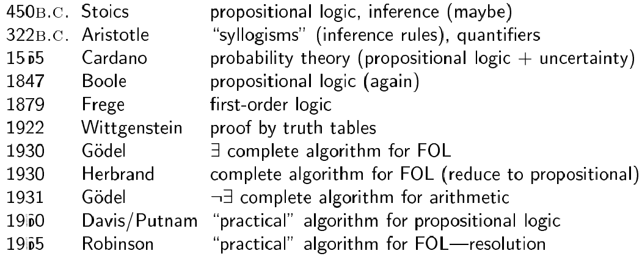
Historical note

Slide 24
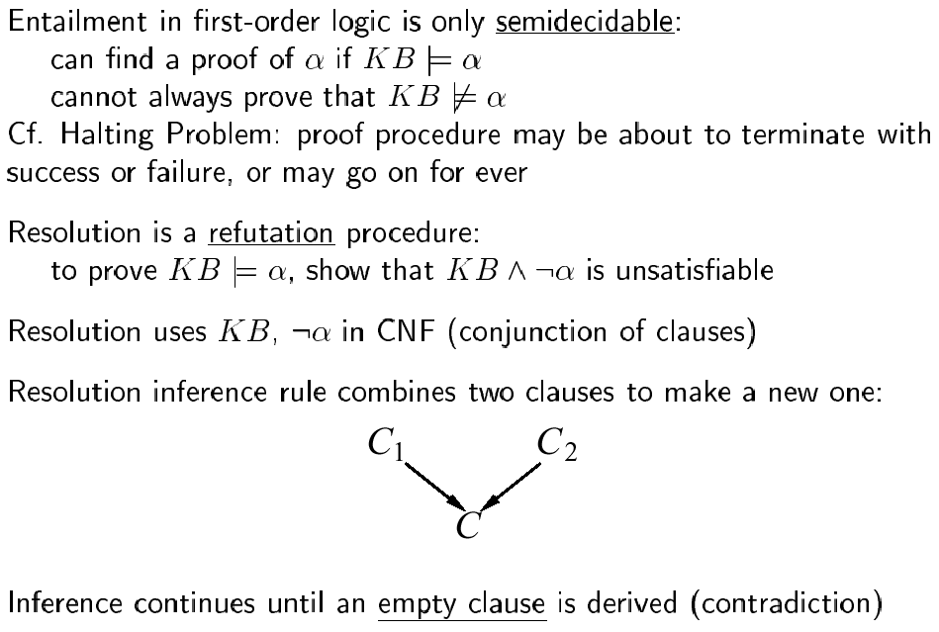
Resolution

Slide 25
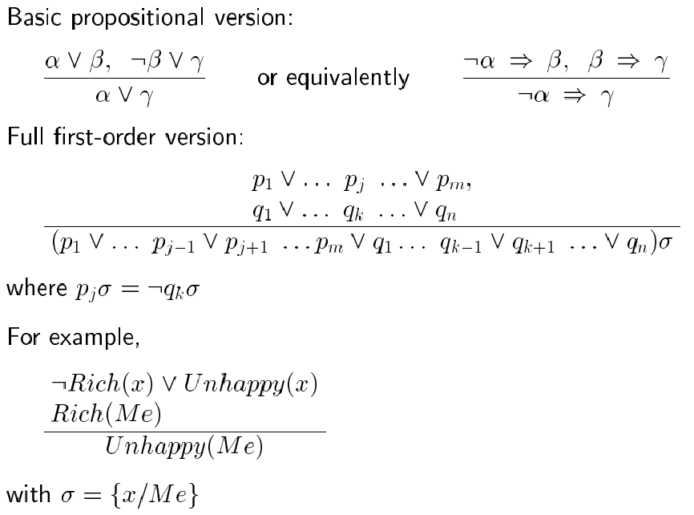
Resolution inference rule

Slide 26
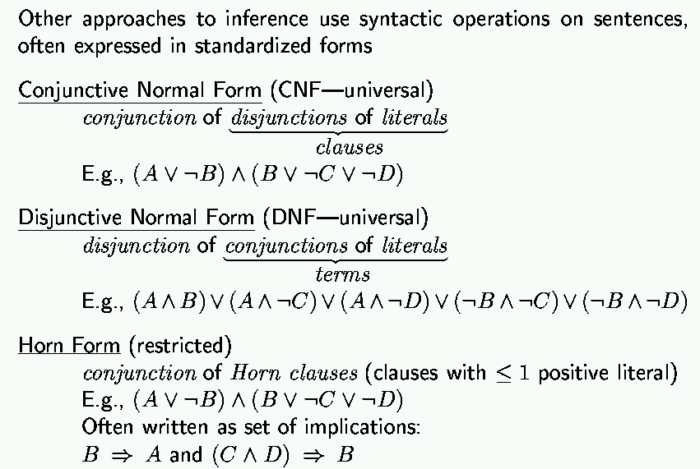
Remember: normal forms
“product of sums of
simple variables or
negated simple variables”
“sum of products of
simple variables or
negated simple variables”

Slide 27
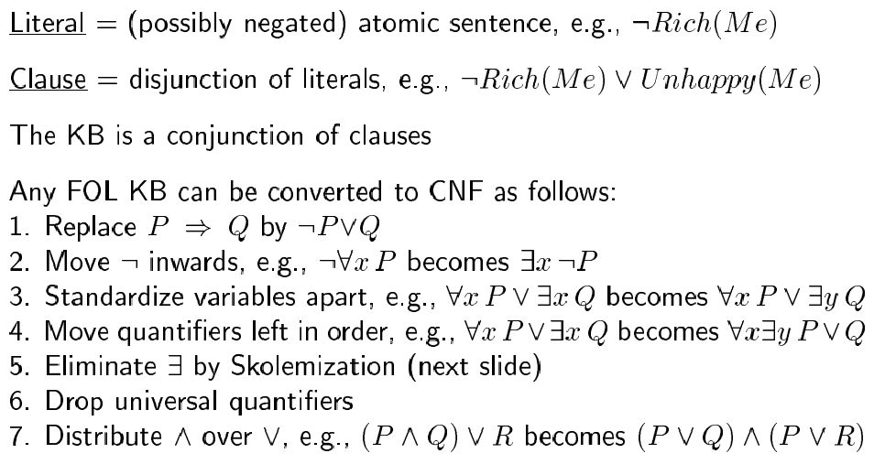
Conjunctive normal form

Slide 28
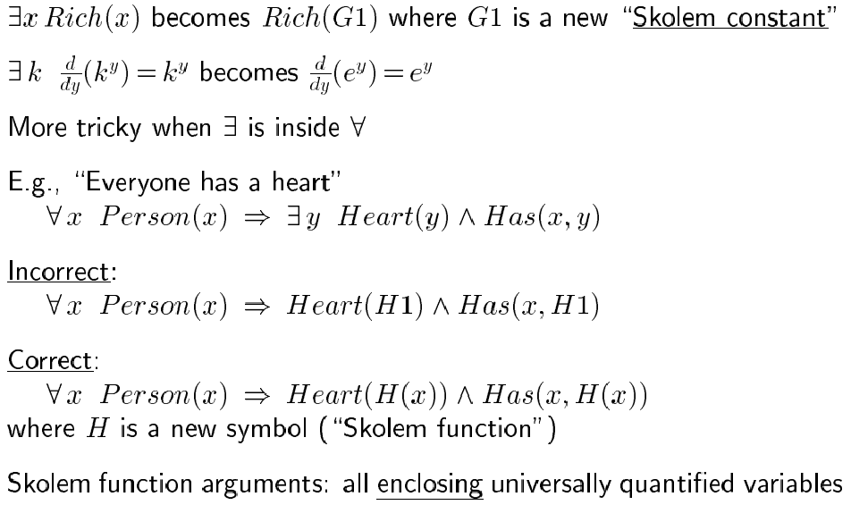
Skolemization

Slide 29
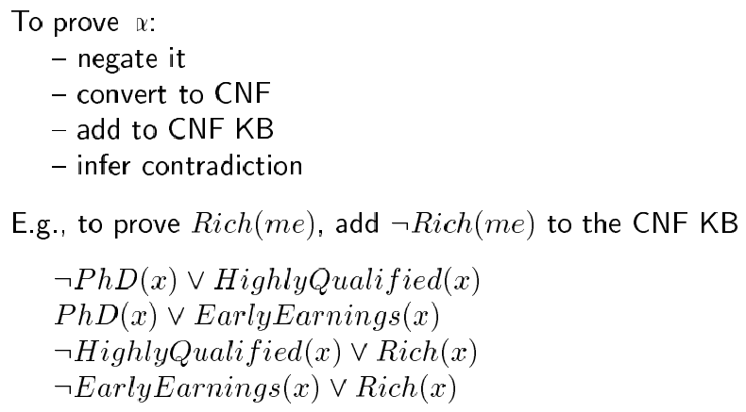
Resolution proof

Slide 30
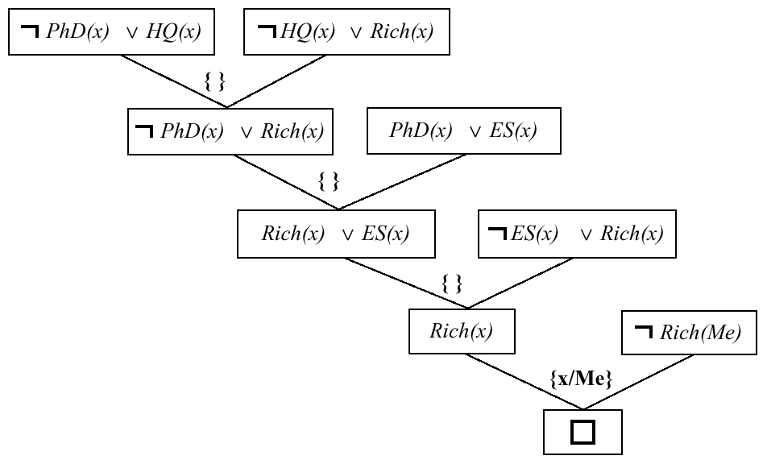
Resolution proof

